Slide 2
ESSA and Other New Developments in Math Education – Key Issues and Opportunities
Diane Briars, President
Matt Larson, President-Elect
Bob Doucette, Executive Director
Ken Krehbiel, Associate Executive Director
National Council of Teachers of Mathematics
ASSM Annual Meeting
April 9, 2016 - San Francisco

Slide 3
Agenda
ESSA Overview and Negotiated Rulemaking
NCTM Resources and New Initiatives
Equity Summit
ARCs
State Advocacy Conference
Other and future issues
High School Issues

Slide 4
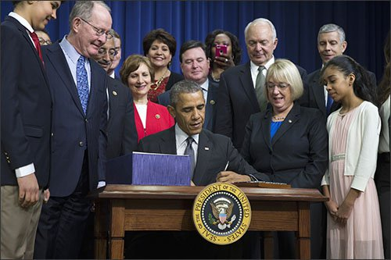
Every Student Succeeds Act (ESSA) Overview
Signed by President Obama on December 10
Last revised 14 years ago
Greatly decreases the role of the federal government in K-12 education
Passed with broad bipartisan support
Passed with support of diverse set of stakeholders

Slide 5
Every Student Succeeds Act (ESSA)
Shifts from NCLB and ESEA Waivers
No requirement for states to implement teacher evaluation systems and/or link results to student test scores
Allows for more fiscal flexibility
Adequate Yearly Progress (AYP) and Highly Qualified Teacher (HQT) eliminated
No focus on “college and career readiness”
Focus on “all children receive a high-quality education and close student achievement gaps”
Expands support for early learning and other factors affecting student learning

Slide 6
Every Student Succeeds Act (ESSA)
Maintains basic architecture of standards-based reform
Annual assessments still required in grades 3-8 in math and reading, once in high school
Science assessments still required once in the three grade bands
SEAs required to set “challenging academic standards”
Annual accountability determinations required
Interventions for lowest-performing 5% of all schools and high schools failing to graduate one third or more of students
Data disaggregation by subgroup: poor, minority, disability, ELLs
Huge shift moving more authority for design of these systems from federal level to states and districts.

Slide 7
Every Student Succeeds Act (ESSA)
No Title I portability
Title II and Title IV funds transferable
49 programs eliminated; new Student Support and Academic Enrichment block grant created
New literacy program (LEARN Act)
New early education component administered jointly through Departments of Health and Human Services and Education (HHS is the fiscal agent)
Decrease in Secretarial authority
Adequate yearly progress (AYP) and highly qualified teacher (HQT) are gone
States determine what interventions to implement

Slide 8
Every Student Succeeds Act (ESSA)
STEM Education
Standards and assessments required in math and science.
States are permitted to use a portion of federal funding provided to support the development of statewide assessments to integrate concepts related to engineering and technology into the states’ science assessments.
States are permitted to establish or improve Alternative Certification of STEM Educators.
State Teacher Quality block grants support STEM professional development, although Math Science Partnerships are eliminated.
States and districts are allowed to provide differential pay, or other incentives, to recruit and retain teachers in high-need academic subjects (such as STEM fields).
National Activities Funds Authorized for STEM Master Teacher Corps and STEM Professional Development.
Creates a new definition for STEM Specialty Schools.
Title IV’s new “21st Century Schools” grants support STEM activities.
Districts receiving more than $30,000 in federal funds would be required to spend at least 20 percent of their funding on “well-rounded” educational activities, with a priority on STEM subjects.

Slide 9
Every Student Succeeds Act (ESSA)
ESSA Effective Dates/Transition
Waivers become null and void on Aug. 1, 2016, but states would still have to continue supporting their lowest-performing schools (what waivers call "priority schools") and schools with large achievement gaps ("focus schools") until their new ESSA plans take effect.
2016-17 will be transition year. It will be partially under the Obama Administration, and partially under a new Administration.
Beginning with 2017-2018 school year, states will need to implement new accountability systems.
Presumably, new programs will be subject to regulation and implemented in 2017-18.

Slide 10
Every Student Succeeds Act (ESSA)
ESSA Funding Transition
Changes take effect for formula programs beginning July 1, 2016.
Changes take effect for competitive programs on October 1, 2016.
Recipients of multi-year awards will continue to receive funding through Sept. 30, 2016.

Slide 11
Every Student Succeeds Act (ESSA)
States MUST adopt challenging standards in mathematics, English language arts/reading, science and MAY have standards in any other subject determined by the state. Standards must:
Apply to all public schools and all public school children.
Align with higher education institution entrance requirements without the need for remediation.
Align with the relevant state career and technical education standards.
Adopt language proficiency standards for English learners.
Allow for alternate academic standards for students with the most significant cognitive disabilities, aligned to challenging state standards.

Slide 12
Every Student Succeeds Act (ESSA) Assessment
States MUST:
Conduct statewide, annual assessments in ELA and mathematics in grades 3-8 and once in high school. Must assess not less than 95% of all students and 95% for each subgroup.
Conduct statewide assessment in science once in grades 3-5, 6-9, 9-12.
Develop an alternate assessment based on alternate academic achievement standards (AA-AAS) for students with the most significant cognitive disabilities. Caps student participation in AA-AAS at 1% by subject, prohibits development of additional alternate assessments.
Identify and make efforts to develop assessments in languages for English learners.

Slide 13
Every Student Succeeds Act (ESSA) Assessment
States MAY:
Exclude ELs from one administration of ELA assessment or exclude the assessment results for accountability purposes for one year.
Allow computer adaptive testing.
Allow LEAs to develop Innovative Assessments under the Innovative Assessment pilot.
Allow LEAs to use a nationally recognized high school assessment in lieu of state assessment.

Slide 14
Every Student Succeeds Act (ESSA) Accountability System
Replaces AYP with a state-defined system and requires:
State-designed long-term goals, measuring interim progress of student subgroups on:
Improved academic achievement on state assessments;
Graduation rates; and
Progress in achieving English language proficiency
Annual meaningful differentiation of schools based on subgroup performance
Statewide indicators must include:
Annual assessment (substantial weight required)
A measure of student growth or other academic indicator for elementary schools
Graduation rate for high schools
Progress of ELs in achieving proficiency
At least one ‘additional’ measure of school quality and student success – must be statewide, comparable, and reliable

Slide 15
Every Student Succeeds Act (ESSA) Title II: Teachers and Principals
State must show that Title I teachers are certified.
State report cards must show qualifications of educators.
Allowable uses of funds for teacher, principal, and other school leaders’ evaluation and support systems based “in part on student academic achievement.”
Must include multiple measures; and
Timely feedback
Allowable uses of funds for induction, mentoring, PD in effective and trauma-informed practices in classroom management, alternative certification, and differential pay systems.
Creates National Activities fund for technical assistance, evaluation, and competitive programs.
Teacher and School Leader Incentive Fund
LEARN program
American History and Civics Education program
Among programs of national significance:
STEM Master Teacher Corps

Slide 16
Every Student Succeeds Act (ESSA) Challenges

Slide 17
Every Student Succeeds Act (ESSA) Assessment
States must:
Implement a system of high-quality, yearly student academic assessments that are:
Aligned to challenging state academic content standards
Address the depth and breadth of those standards
Measure student performance based on challenging State academic achievement standards that are aligned with entrance requirements for credit-bearing coursework in the system of public higher education in the state and relevant state career and technical education standards.

Slide 18
Every Student Succeeds Act (ESSA) Assessment
States may:
Allow LEAs to use a nationally recognized high school assessment in lieu of state assessment.
States must:
Establish and use technical criteria to determine if the assessment:
Is aligned to challenging state academic standards
Addresses the depth and breadth of those standards
Is equivalent to or more rigorous than the statewide assessments

Slide 19
Every Student Succeeds Act (ESSA) Assessment
States may:
Offer a middle school mathematics assessment that would allow middle school students taking advanced mathematics courses to opt out of their grade-level assessment and take only the assessment for the higher-level course.

Slide 20
MSP Transition
How might NCTM support continuing the work of your MSPs?
Don’t forget: ASSM Survey!

Slide 21
Every Student Succeeds Act (ESSA)
Questions
essa.questions@ed.gov
www.ed.gov/essa
Ken Krehbiel
Associate Executive Director for Communications
kkrehbiel@nctm.org

Slide 22
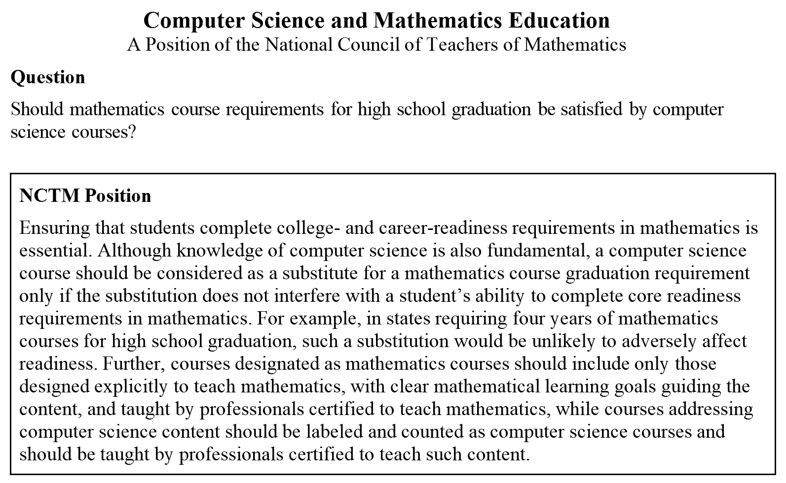
NCTM Position Statements http://www.nctm.org/Standards-and-Positions/NCTM-Position-Statements/

Slide 23
NCTM Position Statements http://www.nctm.org/Standards-and-Positions/NCTM-Position-Statements/

Slide 24
NCTM Major Initiatives
NCTM-hosted Equity Summit
State Advocacy Conference
Principles to Actions Toolkits
New Professional Learning Materials
Classroom Resources Committee
ARCs – Activities with Rigor and Coherence
Innov8 – A new conference experience

Slide 25
NCTM-hosted Equity Initiative
“The status quo is unacceptable.”
A Common Vision for Undergraduate Mathematical Sciences Programs in 2025, MAA, 2015

Slide 27
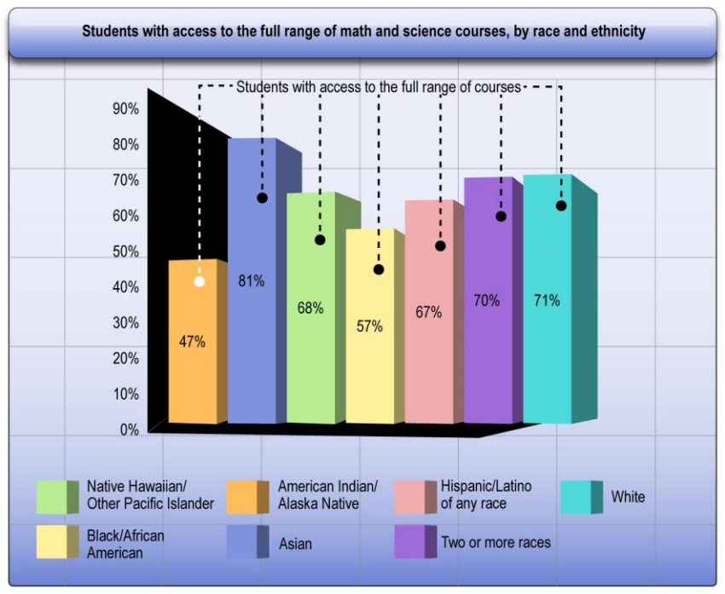

Slide 28
Principles to Actions
Principles to Actions:
Ensuring Mathematical Success for All

Slide 29
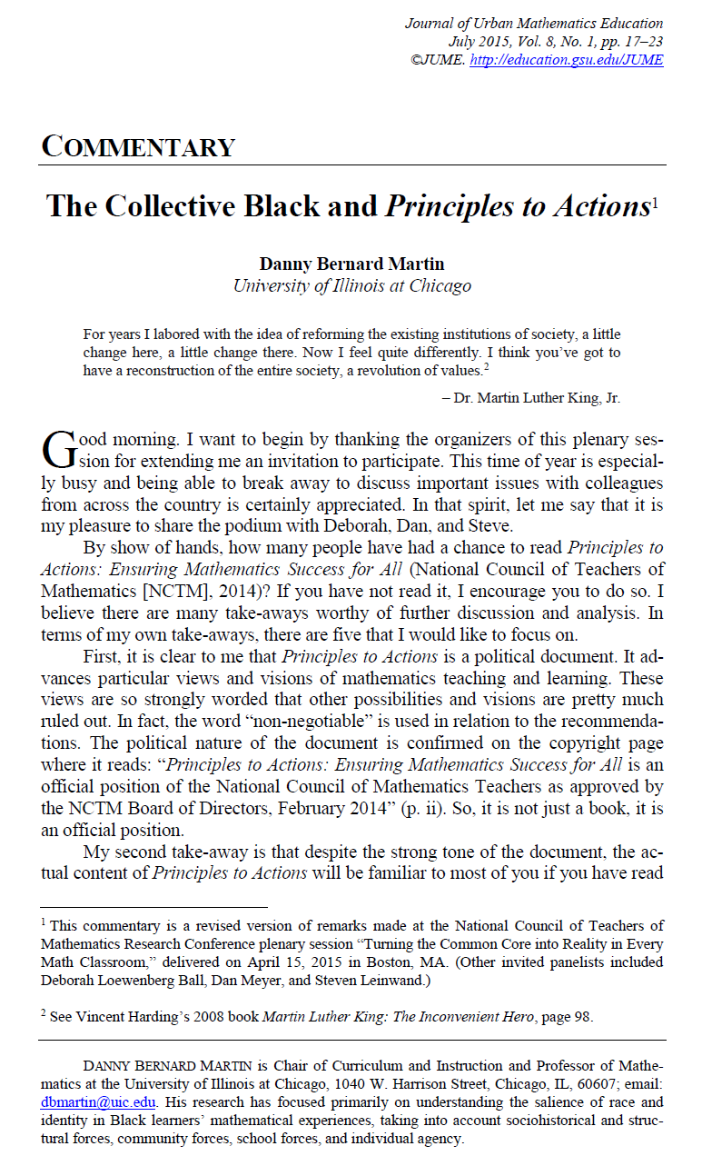

Slide 30
NCTM-hosted Equity Initiative March 24, 2016
AMTE
ASSM
BBA
Journal of Urban Mathematics Education (JUME)
NCSM
NCTM
NASGEm
TODOS
WME

Slide 31
Potential Collaborative Actions
Address issues of access, equity, and excellence explicitly as part of the eight effective teaching practices from NCTM’s Principles to Actions: Ensuring Mathematical Success for All (P2A).
Incorporate discussion/examples of equity issues (e.g., mathematical identity, agency, and positioning students in the classroom) into discussion of P2A effective teaching practices
Examine connections between P2A effective teaching practices and culturally relevant pedagogy and teaching for social justice.
Demonstration project around implementation of P2A effective teaching practices, guiding principles, and other practices that schools/teachers who are successfully with marginalized students.
Public image campaign for the general public, but also students and educators about mathematics and mathematics teaching.
General advocacy
Consistently link: Access, Equity, Excellence and Empowerment

Slide 32
Potential Collaborative Actions
Audiences
Act on two fronts: Teachers (bottom-up) and Administrators (top-down)
Educate coaches regarding effective, equitable practices
Leverage preservice as well as in-service teachers
Culture and Values within and communicated by NCTM
How can we make NCTM’s membership more diverse? Leadership more accessible?
How can NCTM provide more tools that are accessible and relevant?

Slide 33
State Advocacy Conference for Mathematics Education
State department and NCTM state Affiliate leaders from 12 states
Goals
Increase knowledge about effective advocacy re: high-quality mathematics teaching and learning
Develop relationships within and across states to support effective advocacy
Commit to take action
Partners: Hunt Institute, Collaborative for Student Success

Slide 34
Principles to Actions Professional Learning Toolkit
Principles to Actions Professional Learning Toolkit
Grade-band specific professional learning modules focused on the Effective Teaching Practices and Guiding Principles
Presentation, presenter notes, and materials are provided in each module
Notes:
34

Slide 35
Principles to Actions Professional Learning Toolkit
Principles to Actions Professional Learning Toolkit
Support professional learning with teachers through analyzing artifacts of teaching (e.g., mathematical tasks, narrative and video cases, student work samples, vignettes)
Abstract from the specific examples general ideas about how to effectively support student learning.
Notes:
35

Slide 36
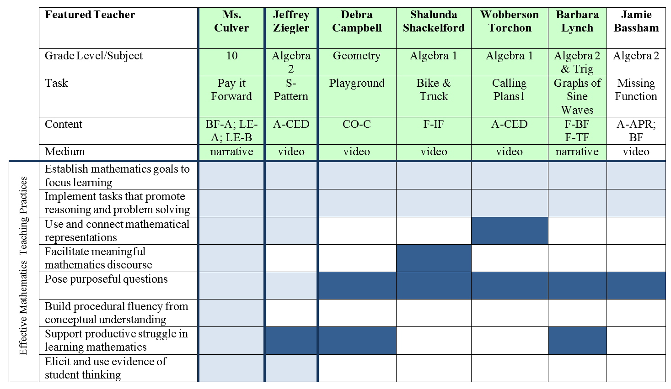
Principles to Actions Effective Teaching Practices Toolkit High School

Slide 37
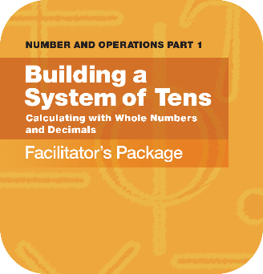
NCTM Publications
Developing Mathematical Ideas Professional Development Series
Module 1 now available
Number and Operations, Part 1: Building a System of Tens

Slide 38
NCTM Publications
Mathematical Understanding for Secondary Teaching –
A Framework and Classroom-Based Situations

Slide 39
NEW NCTM Classroom Resources
The Vision of the Classroom Resources Committee (CRC):
Create an online mathematics education professional learning community that is the go-to site for teachers.
Notes:
Read the Vision
Since the CRC was formed, each grade-band-specific CRDT group has met twice. The first task: CREATE ARCs!
“So what are ARCs?” Next slide…

Slide 40
Activities with Rigor and Coherence (ARCs)
Sequence of 2–4 lessons that
Support Principles to Actions
Address a specific math topic
Scaffold effective teaching
Support the 8 SMPs
Demonstrate the 5 Practices for Orchestrating Productive Mathematics Discussions
Integrate the wide array of NCTM resources
Notes:
Read through each bullet point
After the “integrates…. NCTM resources,” say that, at the first meeting, we started with Illuminations lesson plans that needed revamping.
You might consider asking who has heard of Illuminations, provide background (if necessary).
Make it clear that Illuminations site (and Calculation Nation too) are NCTM sites.
Next slide will show the lesson that was transformed, if applicable.

Slide 41
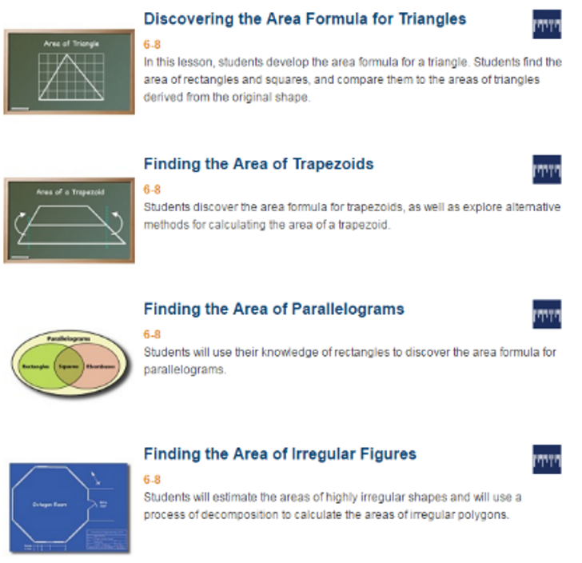
Discovering Area Relationships
of Polygons
Notes:
NOTE: This is actually going to be a WHOLE LOT of slides! You may choose to ask them to go through the “Hook” for example, first. You choose what’s best for all of these middle slides. ☺

Slide 42
Innov8 Premiere
A new hands-on, interactive learning experience
3 Pathways
Response to Intervention (RtI)
Supporting Productive Struggle
Motivating the Learner Who Struggles

Slide 43
Innov8 Premiere
Collaborating with a team
Keynote and expert presentations
Learning Lounge
One-on-one with speakers
Book discussions
Team time to plan and share ideas
New technologies and solutions

Slide 44
NCTM Interactive Institutes www.nctm.org
Engaging Students in Learning: Mathematical Practices, Grades K-8 July 11–13, Atlanta
Engaging Students in Learning: Mathematical Practices and Process Standards, High School July 14–16, Atlanta
Algebra Readiness Institute, Grades 6-8 July 18-20, Denver
Number and Operations Institute, Grades PK-5 July 21-23, Denver

Slide 45
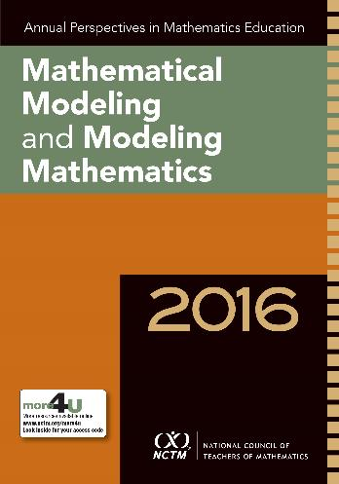
NCTM Publications
Annual Perspectives in Mathematics Education: Mathematical Modeling and Modeling Mathematics

Slide 46
Guidelines for Assessment and Instruction in Mathematical Modeling Education (GAIMME)
What is mathematical modeling?
What does it look like in PK-8, HS, and college?
Appendices with resources and examples

Slide 47
Looking Ahead: Improve High School Mathematics and Pathways to College & Careers
Guidelines for Assessment and Instruction in Mathematical Modeling Education (GAIMME)
Statistical Education of Teachers (SET)
A Common Vision for Undergraduate Mathematics Education Programs, MAA
The Role of Calculus in the Transition from High School to College, D. Bressoud

Slide 48
NCTM Leadership
Diane Briars, NCTM President (2014-16)
djbmath@omcast.net
Matt Larson, NCTM President (2016-18)
Mattlarson94@gmail.com
Bob Doucette, NCTM Executive Director
bdoucette@nctm.org

